Slide 1
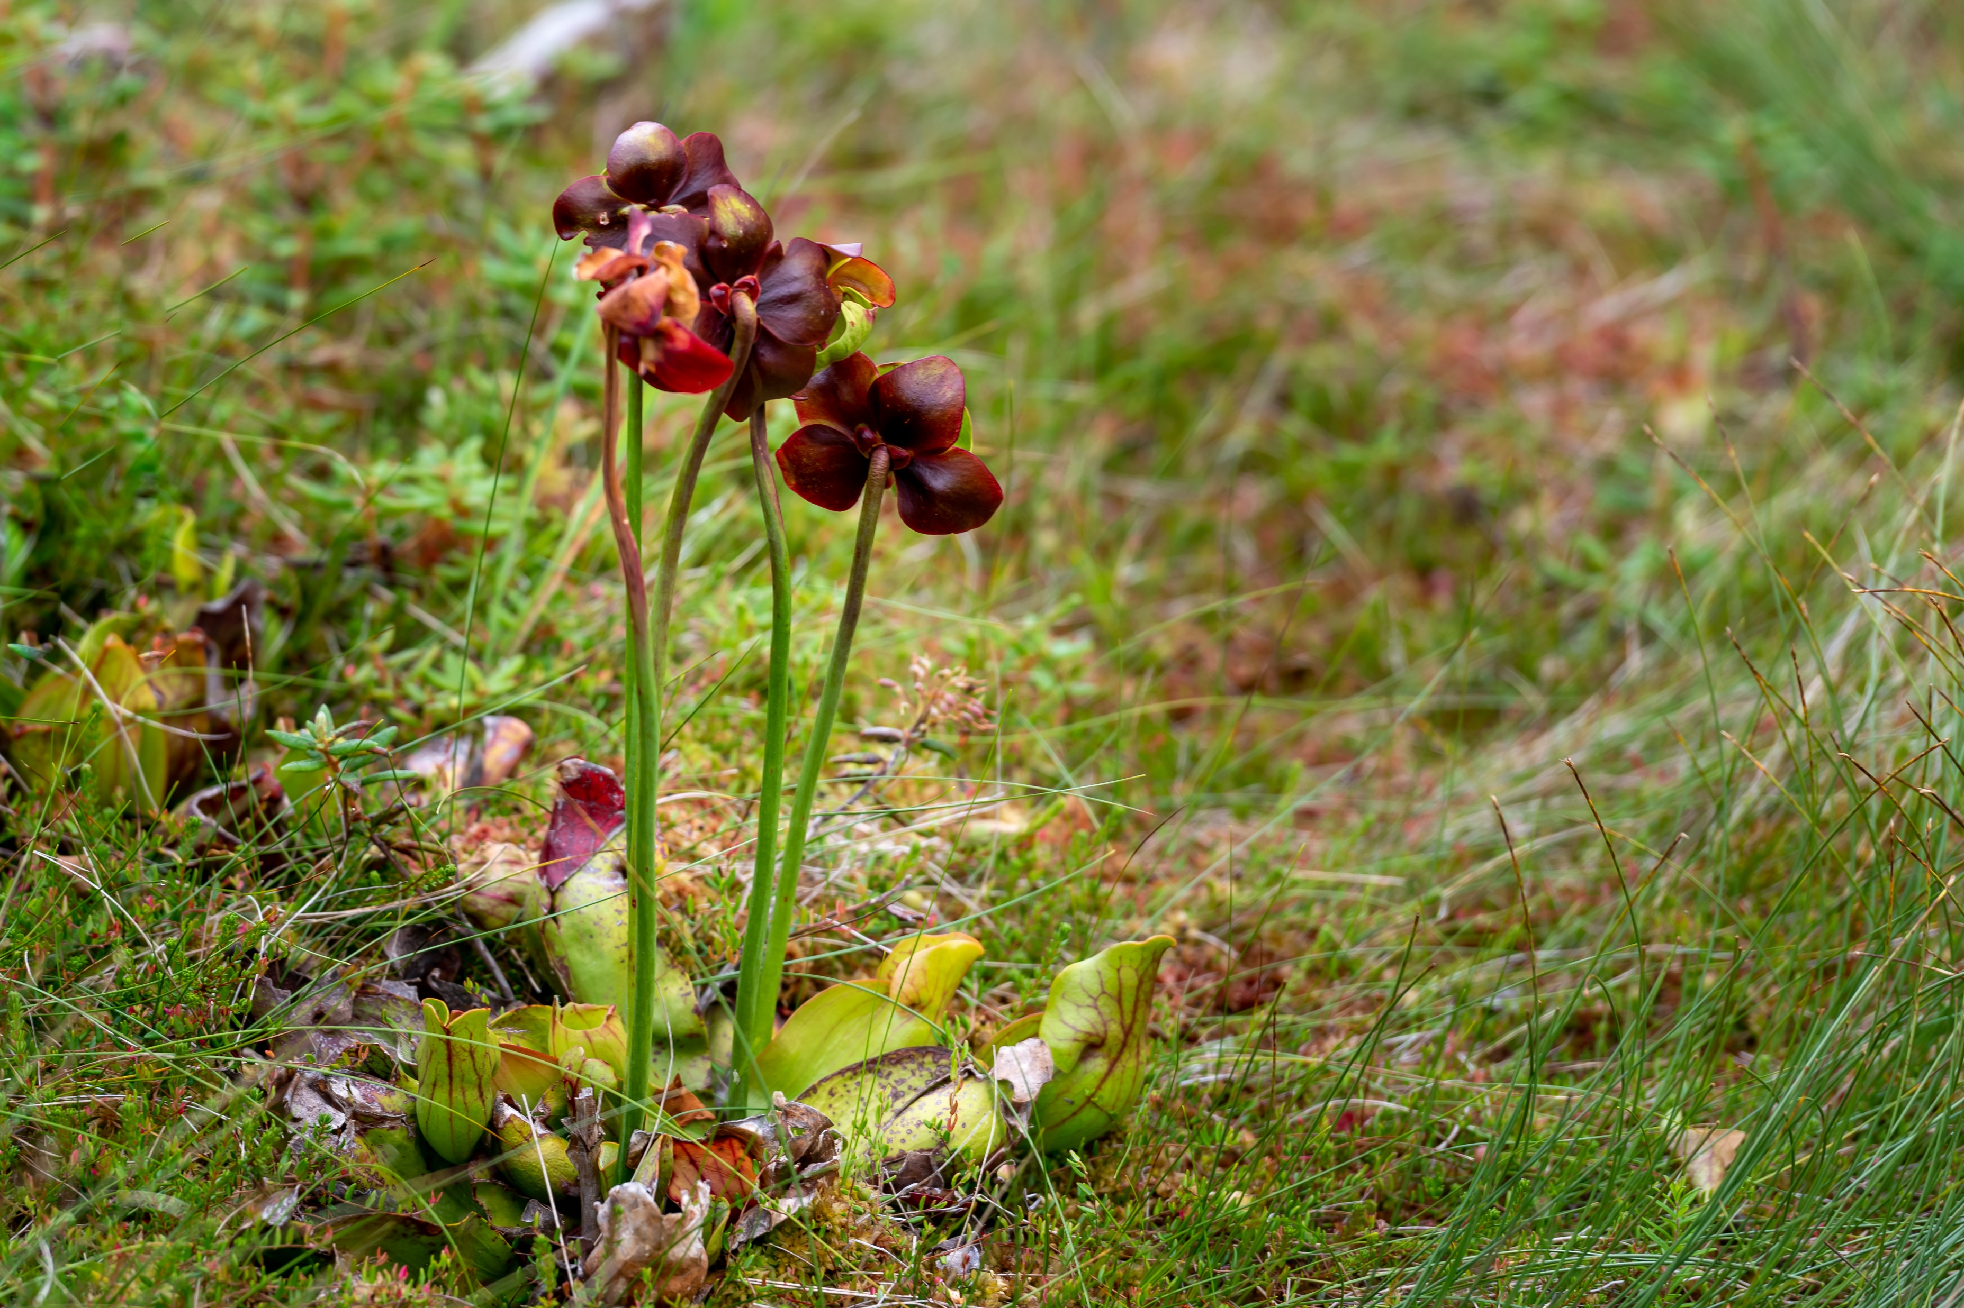
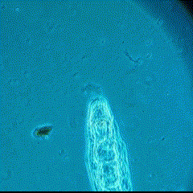

The search for indirect ecological effects of evolution in pitcher plant rotifers
Alex Mendelson
Alex A. Mendelson*, Casey P. terHorst
California State University, Northridge

Slide 2
Eco-evo feedback

Slide 3
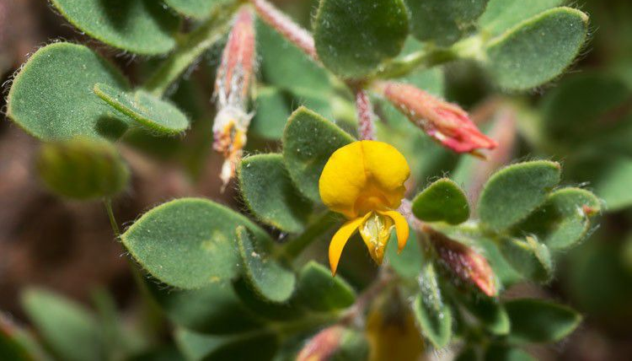
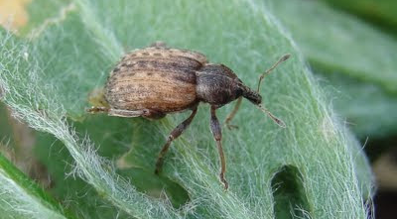
Evolution-mediated indirect effects on ecology
Herbivory
Resistance
Native Plant
Herbivore
Lau, 2012

Slide 4
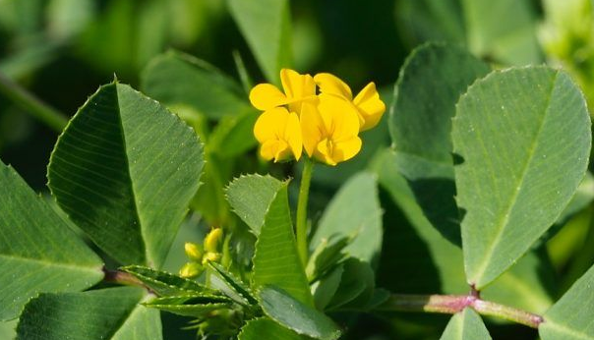
Evolution-mediated indirect effects on ecology
Herbivory
Competition
Resistance
evolution
Native Plant
Herbivore
Invasive Plant
Lau, 2012

Slide 5
Evolution-mediated indirect effects on ecology
Herbivory
Competition
Resistance
evolution
Native Plant
Herbivore
Invasive Plant
Lau, 2012

Slide 6

Evolution-mediated indirect effects on ecology
Species A
Species B
Higher Temp
Interaction
evolution
Climate Change
Indirect effect
Lau, 2012

Slide 7
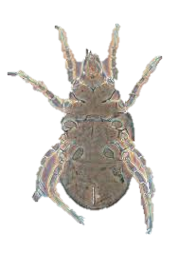
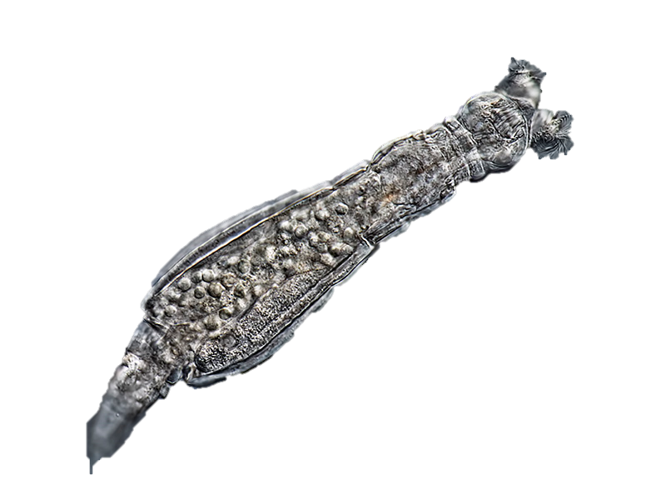
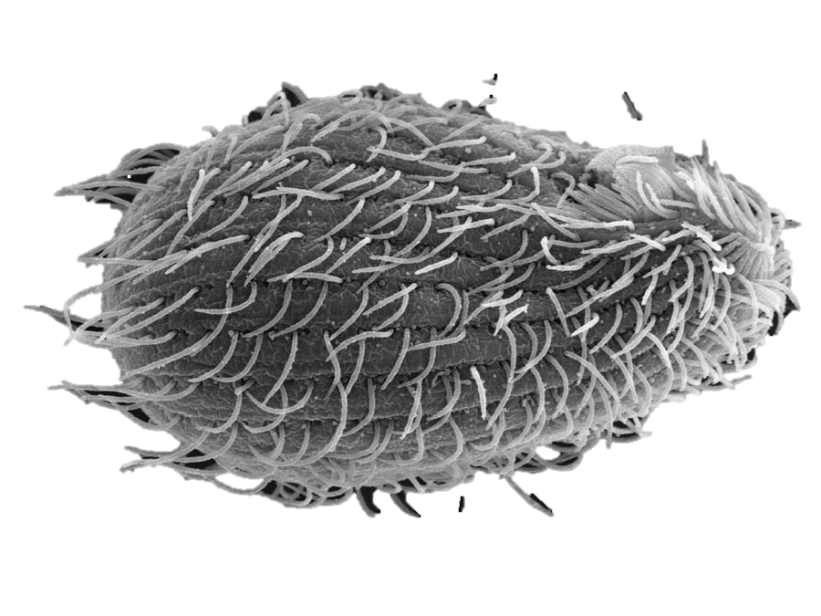
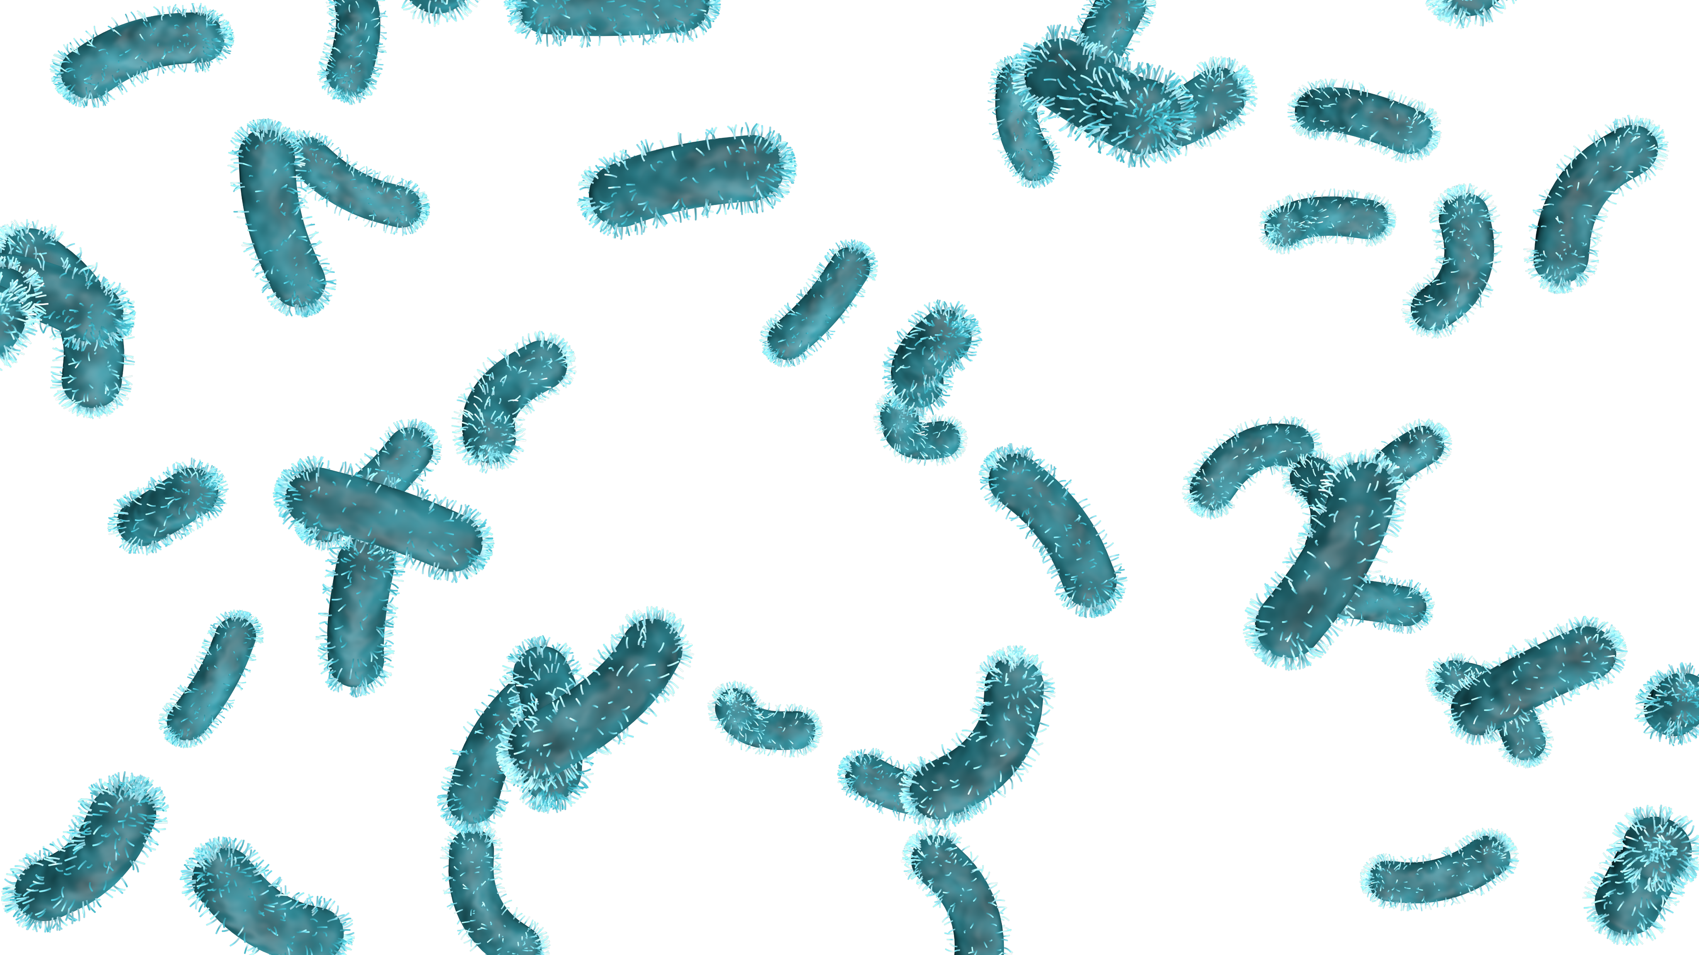
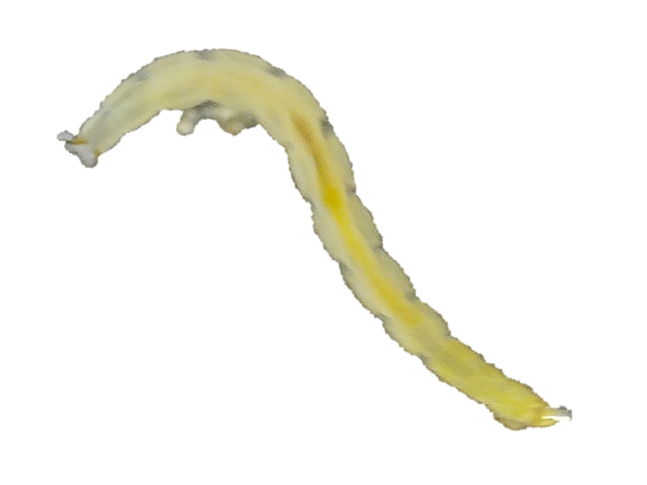
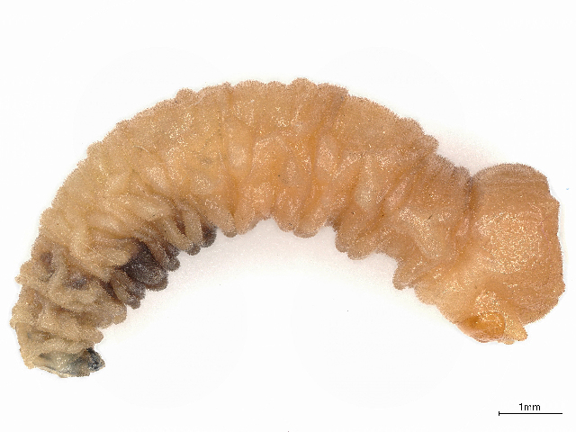
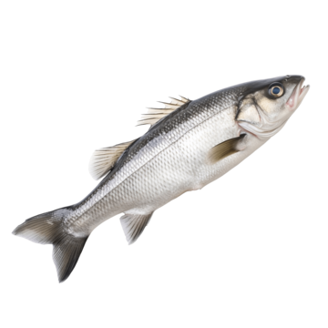
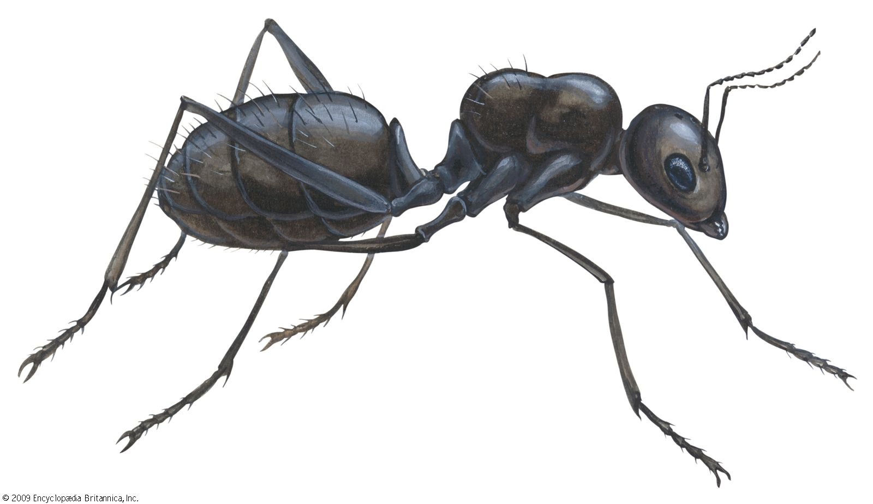
Pitcher plant community
Bacterivores
Omnivores
Rotifers
Protists
Mites
Bacteria
Detritivores
Prey
Midge & Fly Larvae

Slide 8
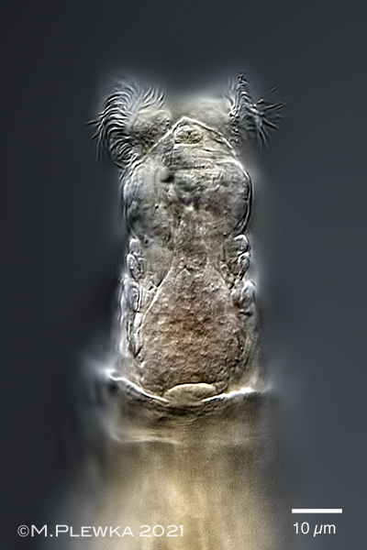
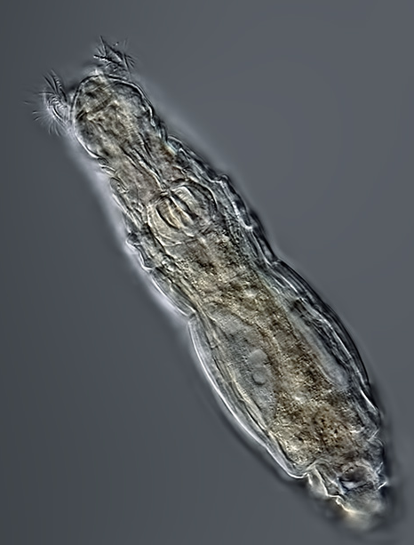
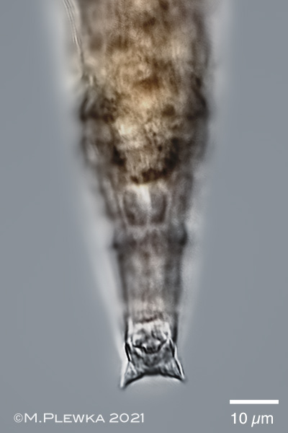
Habrotrocha rosa
Bacterivores
Rotifers
Protists
Michael Plewka
Microbes
Prey
25 µm
Michael Plewka
Michael Plewka

Slide 9
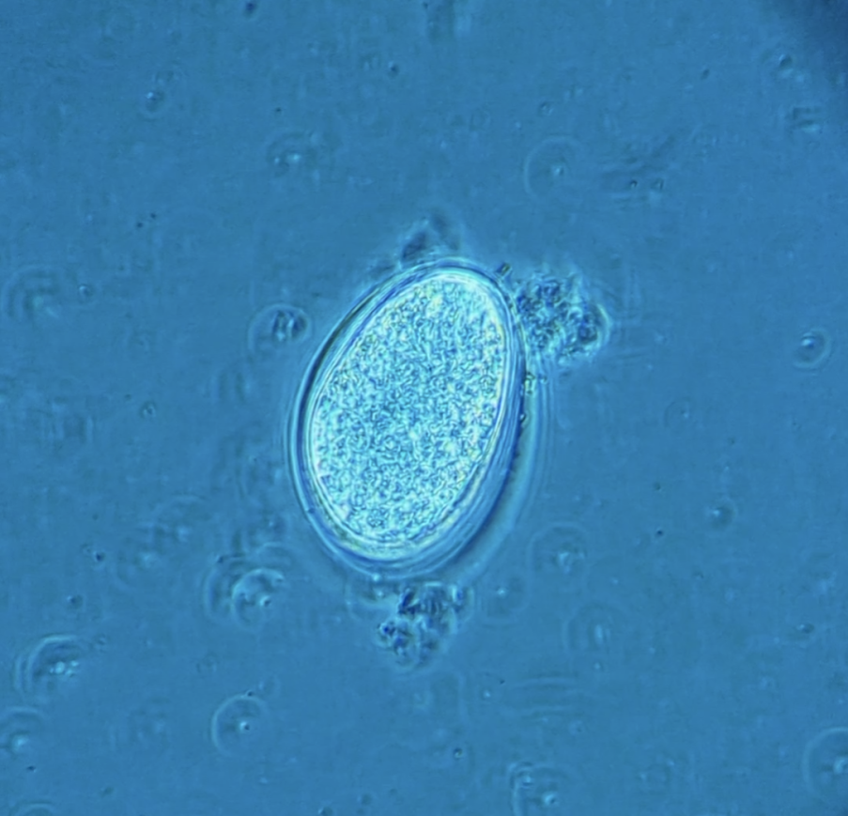
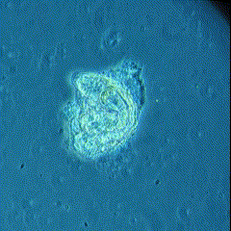
Habrotrocha rosa
Obligately parthenogenetic (apomixis) Offspring are clonal
Generation time 1–2 days
Egg (~6 hours)
Hatching (~12 hours)
Adult (~24-48 hours)

Slide 10
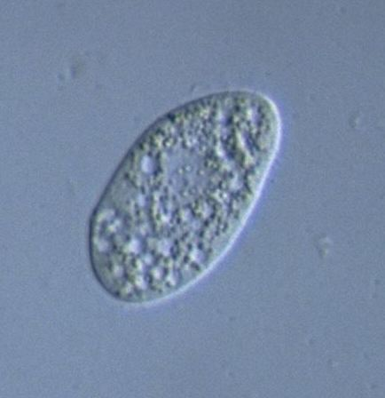
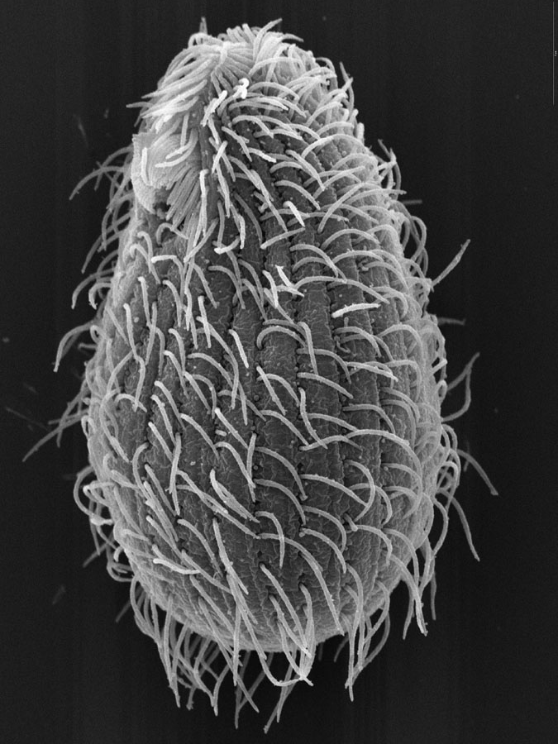
Natural Competitor: Tetrahymena sp.
Bacterivores
Competition
Rotifers
Protists
Microbes
Brian Farley
Y. Tsukii

Slide 11
Do populations of H. rosa evolve in response to temperature?
Do populations of H. rosa evolve in response to temperature?
2. Are populations of H. rosa affected by competition with Tetrahymena sp.?
3. Are there evolution-mediated effects of temperature on competition between H. rosa and Tetrahymena sp.?

Slide 12
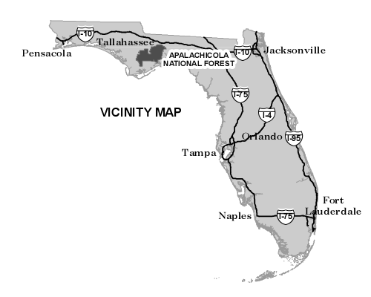
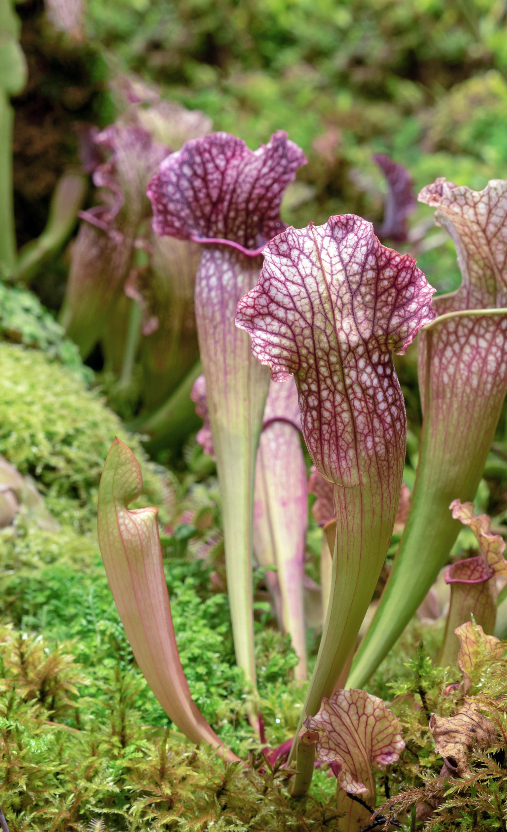
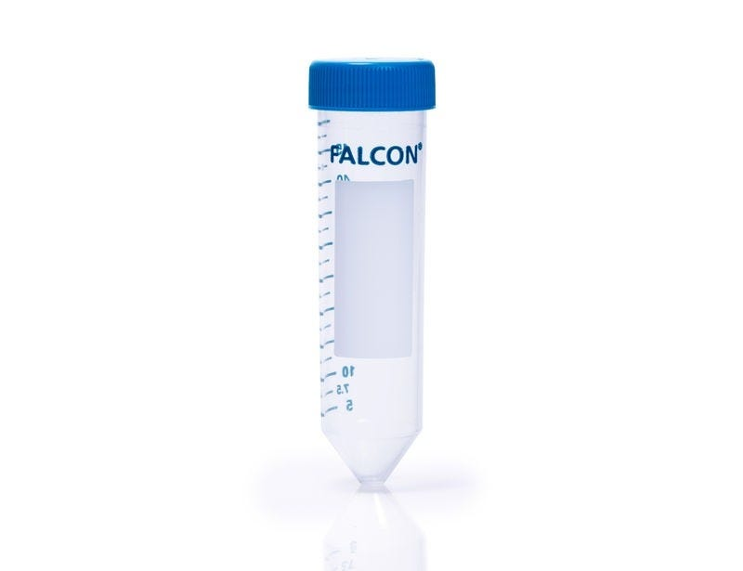
Field Sampling and Isolation
Leaf water
At each of 2 sites:
Sample 5 leaves of different plants that contain H. rosa

Slide 13
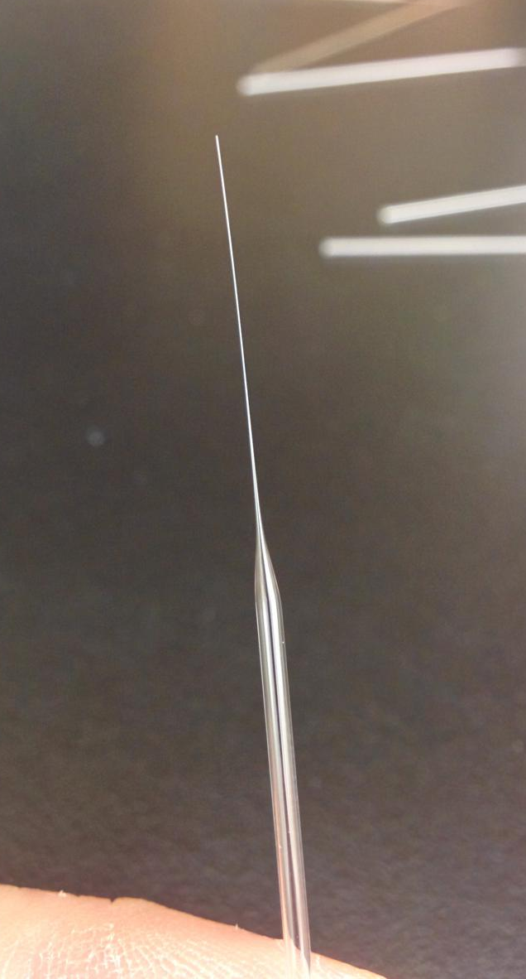
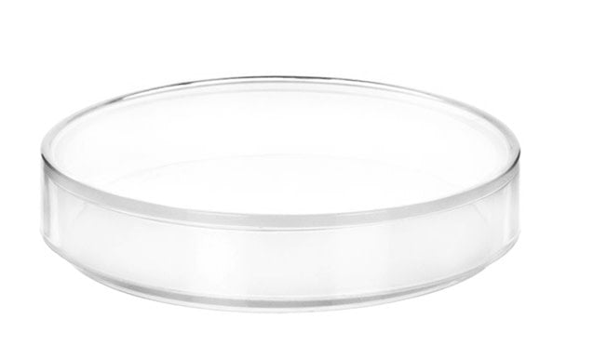
Field Sampling and Isolation
Leaf water
1st Isolation
2nd Isolation
Pulled glass pipette

Slide 14
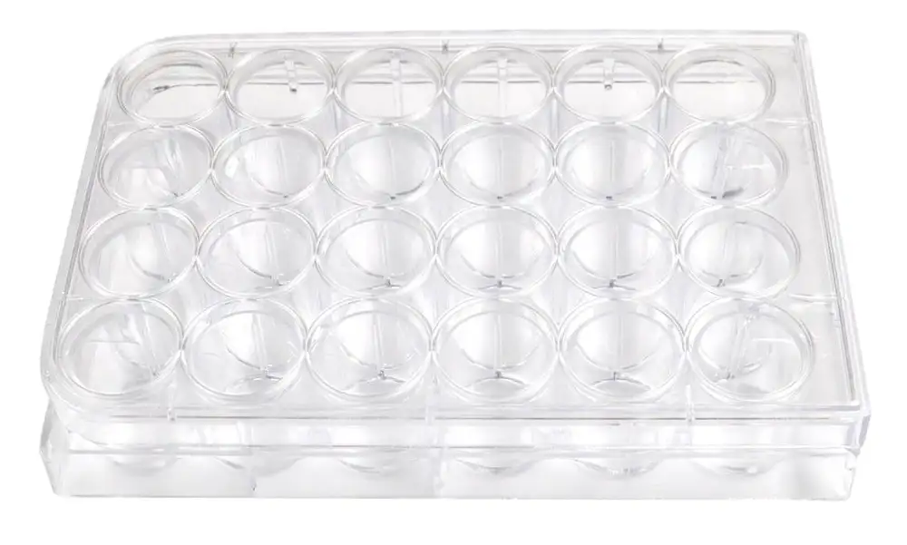
Field Sampling and Isolation
Leaf water
1st Isolation
2nd Isolation
3rd Isolation
24-well tissue culture plate

Slide 15
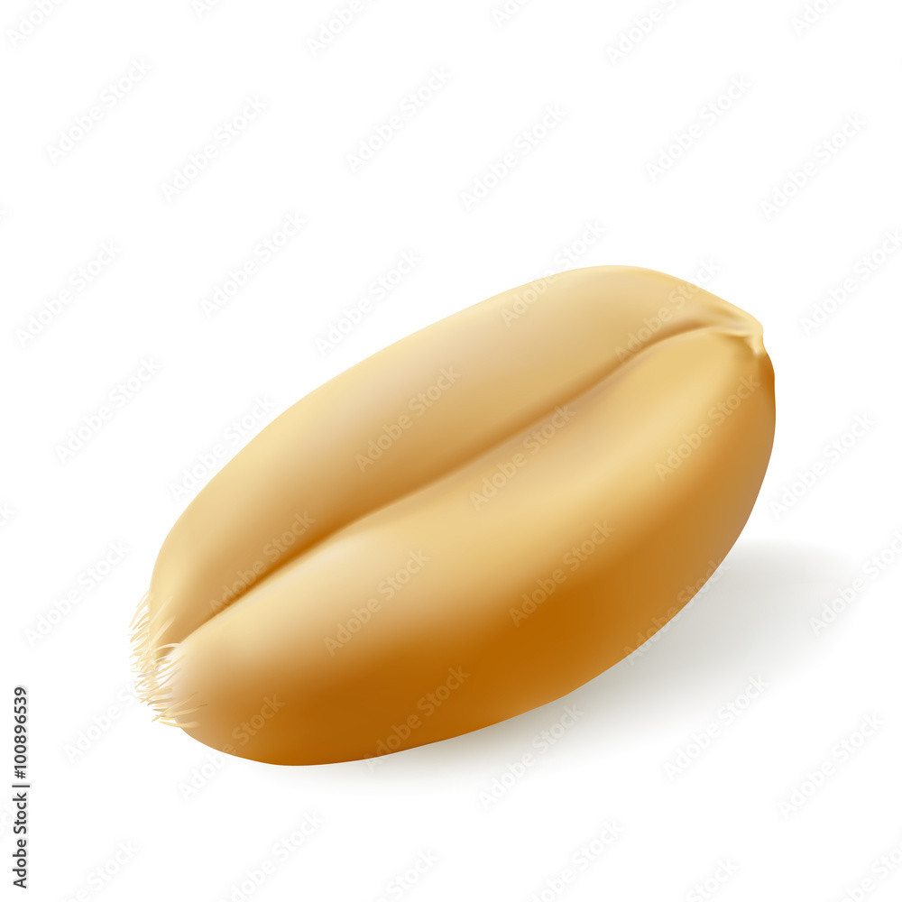
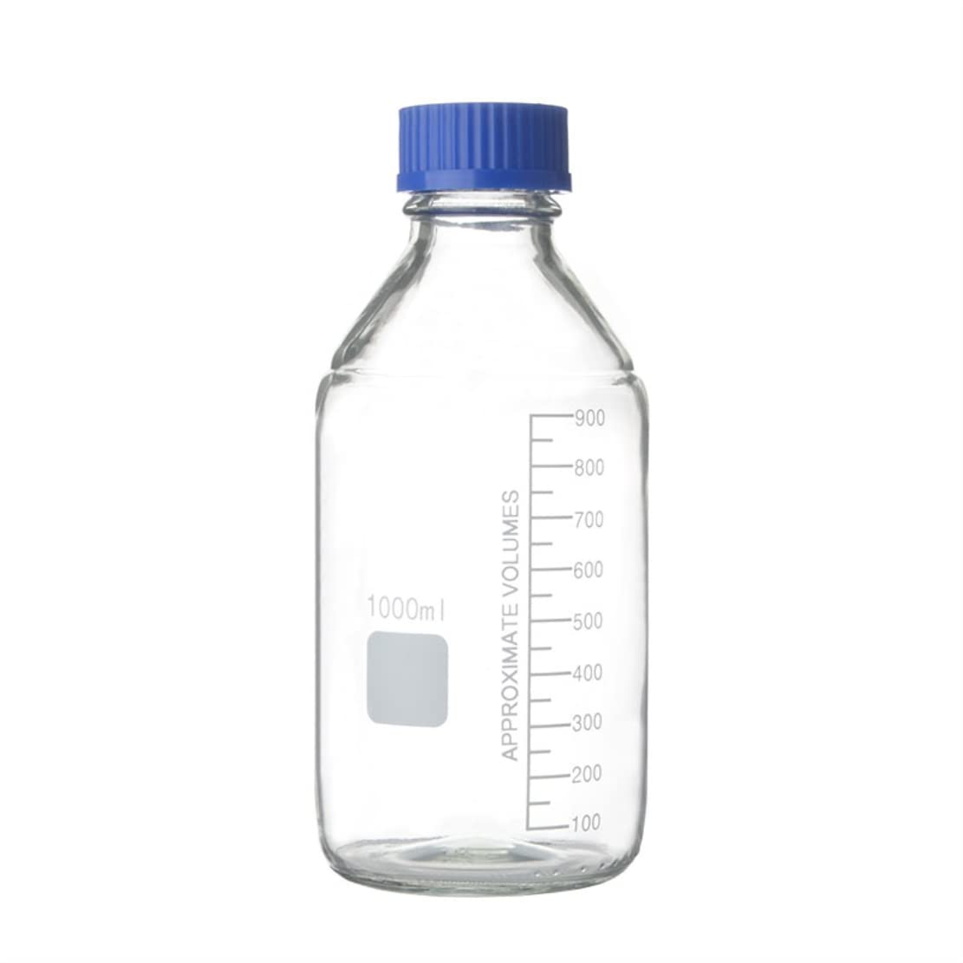
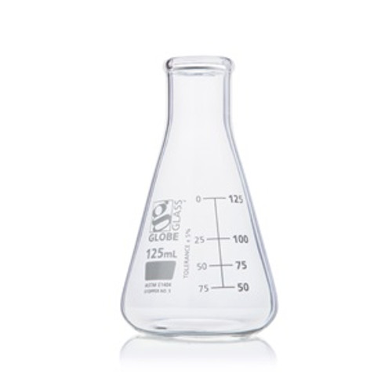
Clonal Stock Cultures
1x
Wheat seed
100 mL
Media
24-well tissue culture plate

Slide 16
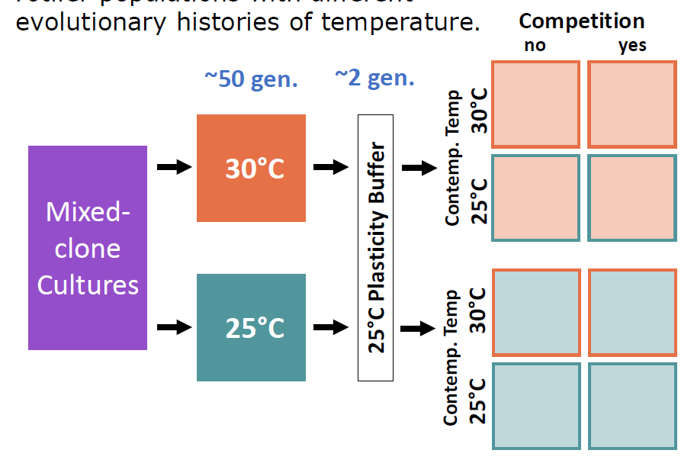
Evolution and competition experiment
n = 17 clones mixed to mimic natural diversity
Mixed cultures fed 200 μL of crushed fish food solution once very 6 days
250 mg sterile, finely ground Tetra Color Tropical Flakes dissolved in 15 ml deionized water
50 generation (120 d) evolution period in temperature-controlled growth chambers
50% ‘water change’ every 40 d
2 generation plasticity buffer
n = 10 for each three-factor cross

Slide 17
Evolution and competition experiment
2 generation plasticity buffer after evolution period
80 new cultures established for full crosses of evolved T, contemporary T, and competition
n = 10 for each three-factor cross
Tetrahymena sp. also grown alone at 25 °C and 30 °C
Protists only
25 °C
30 °C

Slide 18
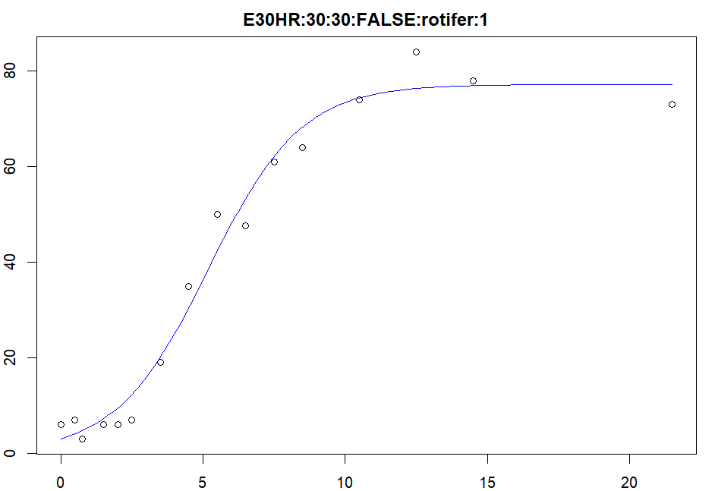
Trait measurement
Growth parameters
Rotifer and protist abundance measured over 21 d
Sampling interval increased over time
Total of 16 timepoints
Logistic growth model
growthrates package (v.0.8.4) in R (v.4.5.1)
Maximum growth rate (r)
Carrying capacity (K)
r = 0.6154
K = 77.1889
Every 6 h
Every 12 h
Every 1 d
Every 2 d
Every 8 d
0d
1d
1.5d
2d
2.5d
3d
4d
7d
9d
13d
21d
d22
6h
18h

Slide 19
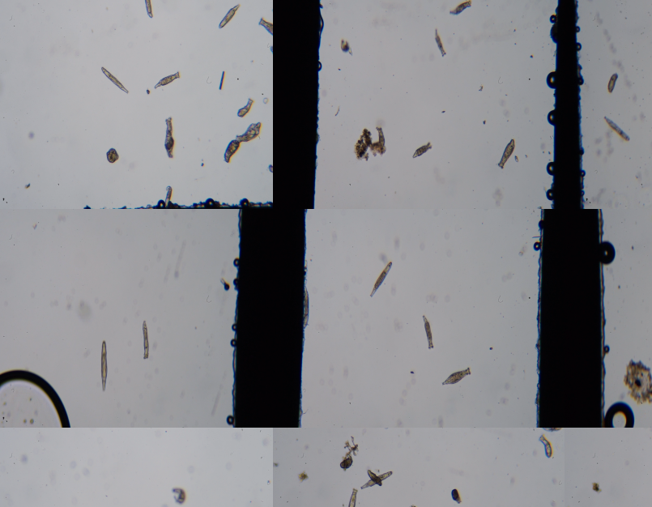
Trait measurement
Size
Rotifers imaged at the beginning of the experiment
n > 200 for each evolutionary history
Data to be analyzed!
Size measured
Every 6 h
Every 12 h
Every 1 d
Every 2 d
Every 8 d
0d
1d
1.5d
2d
2.5d
3d
4d
7d
9d
13d
21d
d22
6h
18h

Slide 20
Analysis

